Slide 1
Capstone project
Andy Tsui

Slide 2
Columns created
First sets of exploration is on pets and children relationships. Following columns are created:
Likes_cats
Likes_pets
Likes_children

Slide 3
Likes cats
cat_mapping = {'likes dogs and likes cats': 1, 'has cats': 2, 'likes cats': 1, 'NA': 0,
'has dogs and likes cats': 1, 'likes dogs and has cats': 2,
'likes dogs and dislikes cats': -1, 'has dogs': 0,
'has dogs and dislikes cats': -1, 'likes dogs': 0,
'has dogs and has cats': 2, 'dislikes dogs and has cats': 2,
'dislikes dogs and dislikes cats': -1, 'dislikes cats': -1,
'dislikes dogs and likes cats': 1, 'dislikes dogs': 0}

Slide 4
Likes_pets
pet_mapping = {'likes dogs and likes cats': 2, 'has cats': 2, 'likes cats': 1, 'NA': 0,
'has dogs and likes cats': 3, 'likes dogs and has cats': 3,
'likes dogs and dislikes cats': 0, 'has dogs': 2,
'has dogs and dislikes cats': 1, 'likes dogs': 1,
'has dogs and has cats': 4, 'dislikes dogs and has cats': 1,
'dislikes dogs and dislikes cats': -2, 'dislikes cats': -1,
'dislikes dogs and likes cats': 0, 'dislikes dogs': -1}

Slide 5
Likes_children
off_spring_mapping = {'doesn&rsquo;t have kids, but might want them': 1, 'NA': 0,
'doesn&rsquo;t want kids': -1,
'doesn&rsquo;t have kids, but wants them': 2,
'doesn&rsquo;t have kids': 0, 'wants kids': 2, 'has a kid': 3, 'has kids': 4,
'doesn&rsquo;t have kids, and doesn&rsquo;t want any': -1,
'has kids, but doesn&rsquo;t want more': 3,
'has a kid, but doesn&rsquo;t want more': 3,
'has a kid, and wants more': 4, 'has kids, and might want more': 5,
'might want kids': 1, 'has a kid, and might want more': 3,
'has kids, and wants more': 5 }

Slide 6
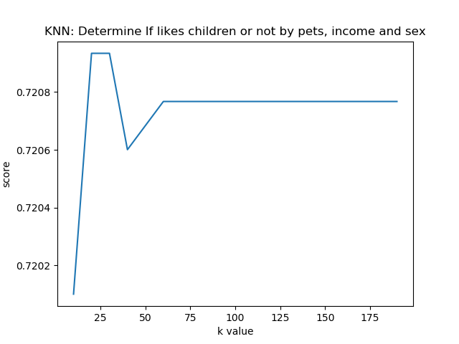
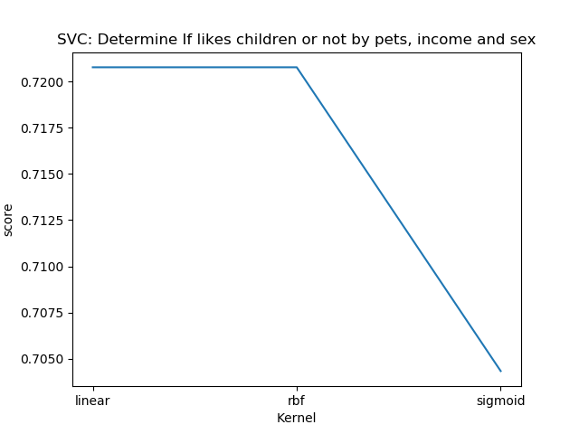
Classification using pets, income and sex

Slide 7
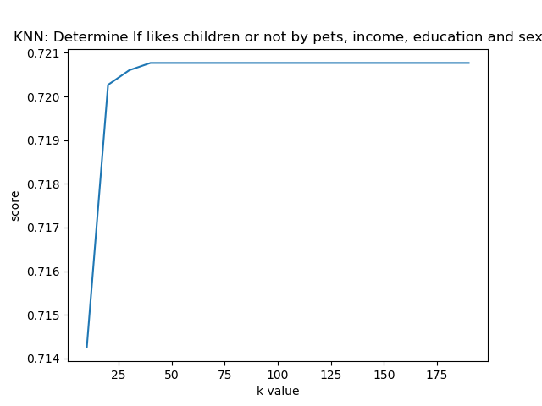
KNN include also education level, no better

Slide 8
Conclusion on classification
SVC(0.720767306088407), KNN(0.720767306088407) and Naïve Bayes(0.720767306088407) all with same value on likes_pets, income, sex, education_level to predict if likes_children or not.
Runtime on KNN is much faster to SVC, with average 3.15s each training iteration while SVC takes 50s for training.
It is also interesting that with or without education level did not affect whether people like children or not.

Slide 9
Regression on income
Trying to find the correlation with the income, education level and essay len. Initially found that in income and essay len there are some outliers, which makes the prediction very difficult to do. E.g. In income, there are about 500 entries with more than 1M of income which the rest of them are less than 400k. Similar happens to essay len. So I try to remove all those outliers with the following method:
removeOutlierSets = data[['income', 'education_level', 'essay_len']]
rs = removeOutlierSets
rs = rs[(rs.income<400000) & (rs.income>0) & (rs.essay_len<50000) ].fillna(0)

Slide 10
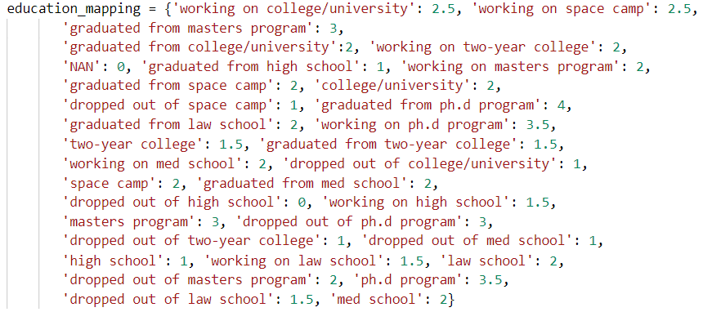
Education level
Since education level is also text based, following is the mapping to turn them into numbers

Slide 11
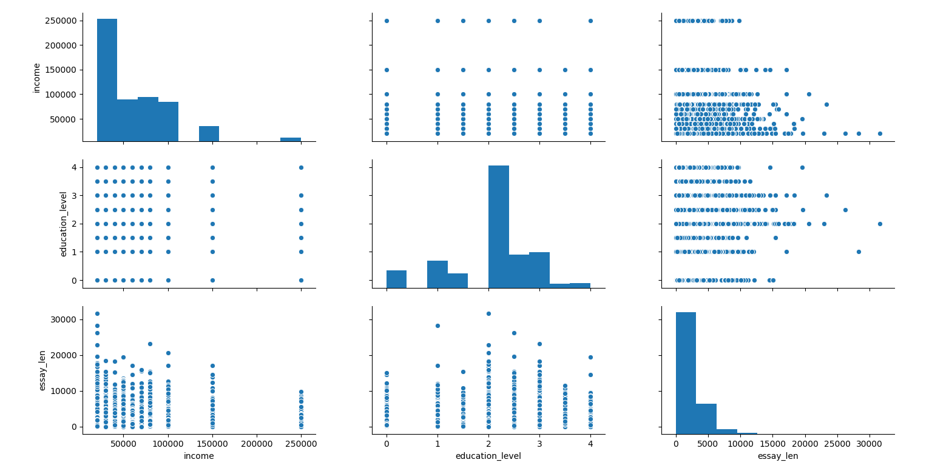
Comparison of data after removing outliers

Slide 12
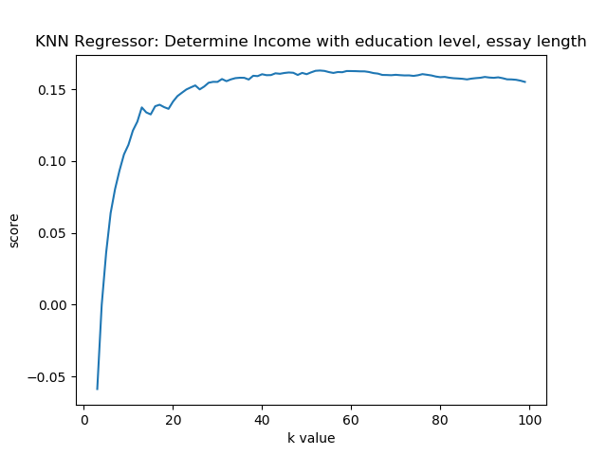
Regression on income
After outliers are removed from data set, about 10K of data remains which should give enough sample to do the Regression.
With KNN regressor, the score is really bad (max at about 0.16)

Slide 13
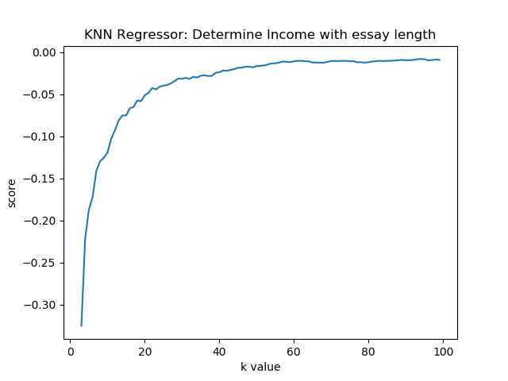
KNN on Income vs Essay Length
Doing KNN only on income vs essay length, result is even worse

Slide 14
Determine income using Linear Regression
Since using Essay len on income is very poor in result (Linear / KNN) so I tried to use all quantity I have: age, education_level, smokes_code, drinks_code, sex_code, likes_pets, likes_children, height
All combinations is tested to find a best score, but still, the best is about 0.19 which is even worst than random guessing.

Slide 15
Conclusion
There’s no obvious relationship between income to other variables for what I can find. Maybe further exploring the content within the essay could help.

